Slide 1
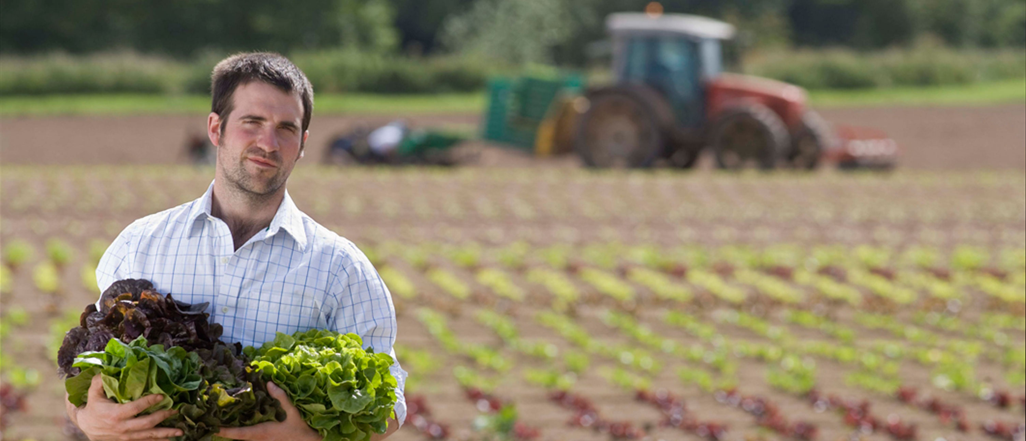

Slide 2
Strategic Communications Planning
Ruth Hohl Borger, Ed.D., APR
Assistant Vice President
IFAS Communications
December 12, 2012
rborger@ufl.edu
352-392-2411 ext 293
Ifas.ufl.edu

Slide 3
Overview
Why plan?
What’s so strategic about it anyway?
Basics of a strategic pr/communications plan
Implementing this approach
What’s in it for YOU?

Slide 4
Why Plan?
Too many options, not enough resources
Focus, focus, focus
High stakes
Crisis situations
Other reasons?

Slide 5
Planning is the only rational way to establish priorities in using always too little money and too few personnel. Unless there is a plan, the public relations staff will be tugged this way and that by competing internal demands.
Cutlip, Center, and Broom, Effective Public Relations (Englewood Cliffs, NJ: Prentice-Hall, 1985), p. 231.

Slide 6
What’s so strategic about it?
strat·e·gy /ˈstræt ɪ dʒi/ noun, plural strat·e·gies.
1. Also, strategics. the science or art of combining and employing the means of war in planning and directing large military movements and operations.
2. the use or an instance of using this science or art.
3. skillful use of a stratagem: The salesperson's strategy was to seem always to agree with the customer.
4. a plan, method, or series of maneuvers or stratagems for obtaining a specific goal or result: a strategy for getting ahead in the world.
http://dictionary.reference.com/browse/strategy?s=ts

Slide 7
What are some examples where you have used planning?

Slide 8
What were the challenges you faced?

Slide 9
Basics of a strategic PR/Communications Plan

Slide 10
A Public Relations Approach
Public relations is the management function that identifies, establishes and maintains mutually beneficial relationships between an organization and the various publics on whom its success or failure depends.
Cutlip, Center, and Broom. Effective Public Relations. 1986 (6th edition) p. 4.

Slide 11
Multi-step Planning part one
Situation
Goals/Objectives
Research/Findings/Strategies
Audiences
Messages

Slide 12
Multi-step Planning part two
Implementation
Budget
Timetable
Evaluation

Slide 13
Case Study
Celebrating the 150th Anniversary of the Morrill Act

Slide 14
The Morrill Act is the legislation that established the land grant system in America.
UF is participating in the national commemoration to be held in late June and early July in Washington, D.C. Activities include an exhibit as part of the Smithsonian Institution’s annual Folklife Festival and special events organized by the Association of Public Land Grant Universities [APLU].

Slide 15
Situation
• 150th anniversary of the signing of Morrill Act that created land grant system
• There is a perceived lack of awareness and understanding of land grant mission
• There is a perceived erosion in the value of higher education across the state and nation and especially among key stakeholders

Slide 16
Goals/Objectives
Raise awareness and understanding of the unique mission of the land grant institution from a broader population of stakeholders
Engage the entire university community in the celebration
Inspire and empower faculty, staff and students to live the land grant mission in their professional work
Communicate and create value for the University of Florida’s unique status as one of the land grant institutions for the state

Slide 17
What other goals might we have considered?

Slide 18
Research
What type of research could I have looked at ?

Slide 19
Public opinion
Knowledge of what a land grant is?
Secondary research
Anecdotal research

Slide 20
Strategies
Reflect on past, celebrate the present, focus on the future
Engage entire campus
Be open to many forms of expression

Slide 21
Audiences
Campus community: students, faculty, staff
General Public
Alumni
Legislature
Donors
Media
Sister land grant institutions

Slide 22
Messages
Land grants: a bold idea that higher education can exist for citizens of ordinary means; the foundation of a democratic society
We are by our mission challenged to bring higher education to a wide audience, and particularly people of ordinary means [who is that in today’s society – the disenfranchised, immigrants, first generation college attendees?]
The land grant mission is one that adopts and implements an integrated approach to research teaching and outreach.
The need for the land grant institution is as relevant now as in 1862. The areas that we work in should be ever changing to reflect our communities’ needs. Our focus is ever changing; our mission never changing.

Slide 23
Implementation
IDENTITY
SPEECHES
EVENTS/SPECIAL EVENTS
EXHIBITS
LECTURE SERIES
PUBLICATIONS
MEDIA
CAMPUS SIGNAGE

Slide 24
Implementation
www.landgrant.ufl.edu
http://ifas.ufl.edu/land_grant_history/IFAS-landGrant/index.shtml#templates

Slide 25
Graphic Element

Slide 26
Exhibits
http://www.festival.si.edu/2012/campus_and_community/sustainable_solutions/univ_florida.aspx
http://plants.ifas.ufl.edu/water/

Slide 27
Videos
http://www.youtube.com/watch?v=Q6d1Zy7EkFA&feature=related
http://www.youtube.com/watch?v=_dY1BrB0M3c&feature=relmfu

Slide 28
Outcomes
Greater awareness and understanding of what it means to be a land grant institution
Enhanced reputation that UF is a Flagship institution for Florida and nation
Increased pride that UF is a land grant institution
Increased value of public higher education

Slide 29
Questions
Thank you!

